Slide 1

CASE STUDY on
DRIVING FACTORS behind LOAN DEFAULTERS
Presented By- Nithyashree PV
Saptarshi Ganguly

Slide 2
SUGGESTIONS ABOUT MISSING VALUES & OUTLIERS

Slide 3
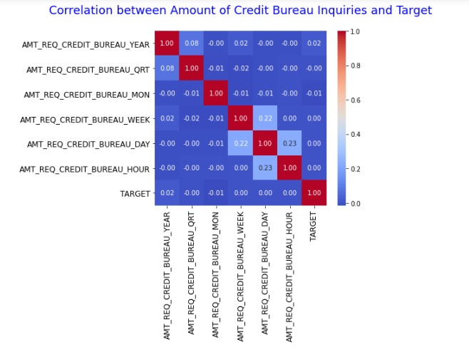
From the given heatmap we can see that the columns: AMT_REQ_CREDIT_BUREAU_YEAR AMT_REQ_CREDIT_BUREAU_HOUR AMT_REQ_CREDIT_BUREAU_DAY AMT_REQ_CREDIT_BUREAU_WEEK AMT_REQ_CREDIT_BUREAU_QRT have no correlation to the Target variable column.
Hence, these can be dropped from current data.

Slide 4
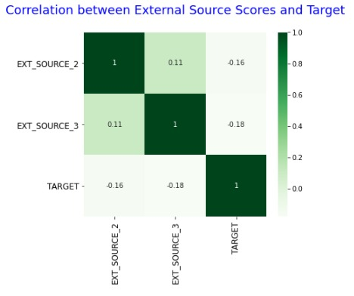
According to the above heatmap, we can see that both columns have almost no correlation with the Target variable column. We can drop these columns for a cleaner analysis.

Slide 5
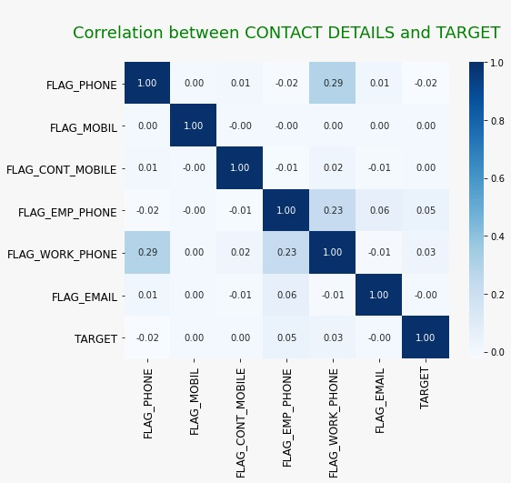
From the given heatmap we can see there is no correlation between these variables and the target variable, and therefore we will drop these columns.

Slide 6
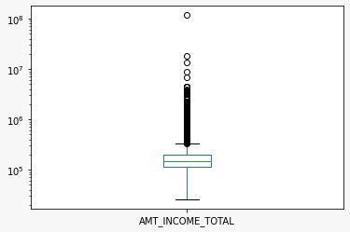
BOX PLOT for INCOME AMOUNT
We can see the farthest outlier for this column(the maximum value) is significantly higher than the other values. This can skew the data if not treated properly.
However, we recommend capping the data at the 99th percentile so we can keep the data and analyze. With capping, we prevent loss of information that these outliers provide. The number of outlier rows are significant enough that they are valuable data that can contribute to understanding the attributes better. Deleting them would affect the overall analysis of the variable.
Hence, deletion is not recommended for these rows.

Slide 7
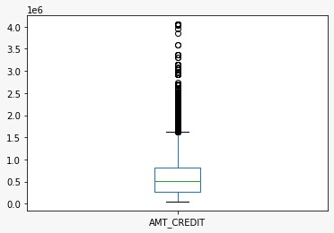
BOX PLOT for CREDIT AMOUNT
Suggestion:
We recommend capping the data at 99th percentile. Being cognizant of the extreme outlier in this column, and refraining from using mean (due to its sensitivity to outliers) and looking at the median/quantiles for its analysis.

Slide 8
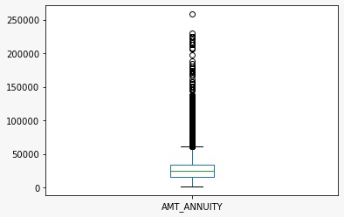
BOX PLOT FOR ANNUITY AMOUNT
Suggestion:
There are many outliers in this column, and hence it is not ideal to delete these values. Binning would be recommended for the Annuity column to understand the nature of the many outliers present.

Slide 9
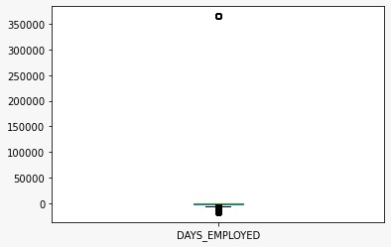
BOX PLOT for DAYS EMPLOYED
The maximum entry is 365243 days (i.e, 1000 years of employment) which is impossible and an extreme outlier which needs to be removed.
The number of outliers with an incorrect entry in this column are significant enough to affect our analysis. We recommend changing these values to np.Nan.

Slide 10
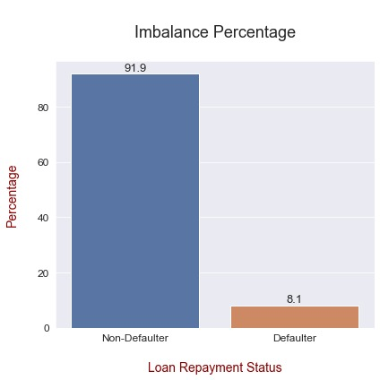
IMBALANCE ANALYSIS
Inference:
The percentage of Non-Defaulters is almost 92% and that of Defaulters is 8% for the application data.

Slide 11
CATEGORICAL UNIVARIATE ANALYSIS

Slide 12
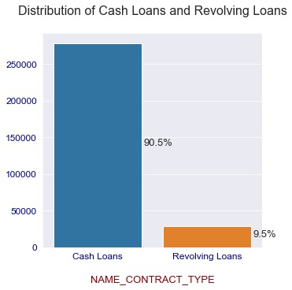
INFERENCE:
Revolving Loans make up 10% of the total distribution of loan contract type. Cash Loan are 90% of the total contract type among the applicants.
2) Cash Loan are 90% of the total contract type, which means applicants prefer to apply for Cash Loans.

Slide 13
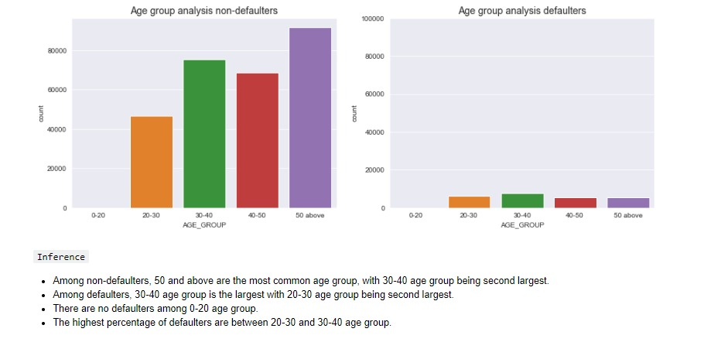

Slide 14
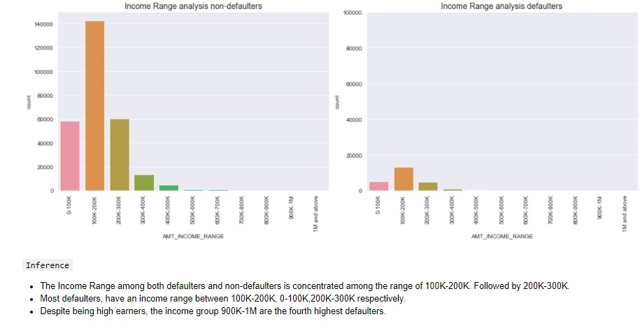

Slide 15
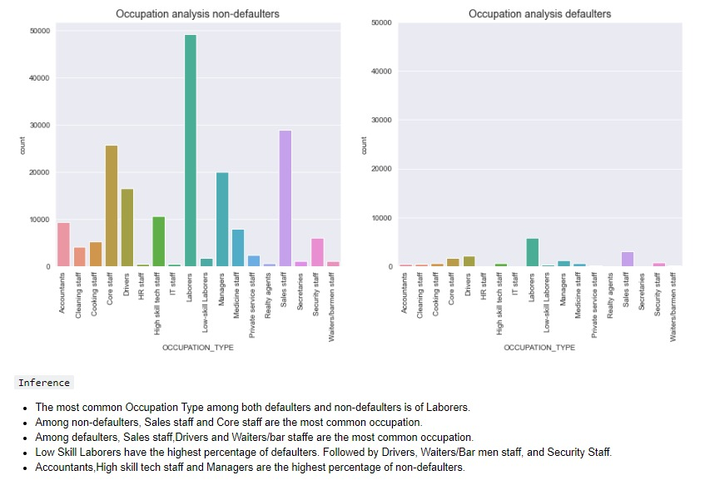

Slide 16
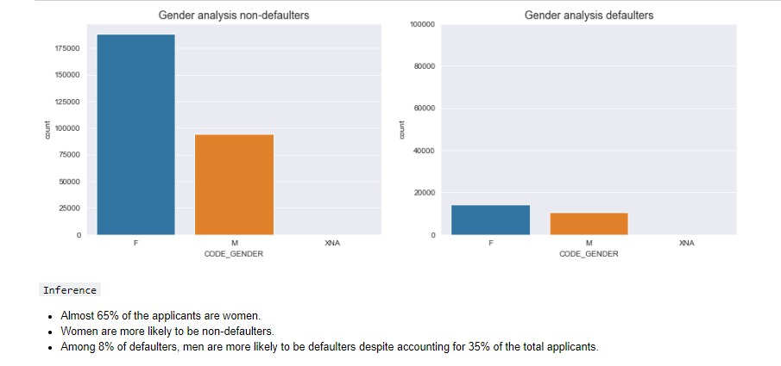

Slide 17
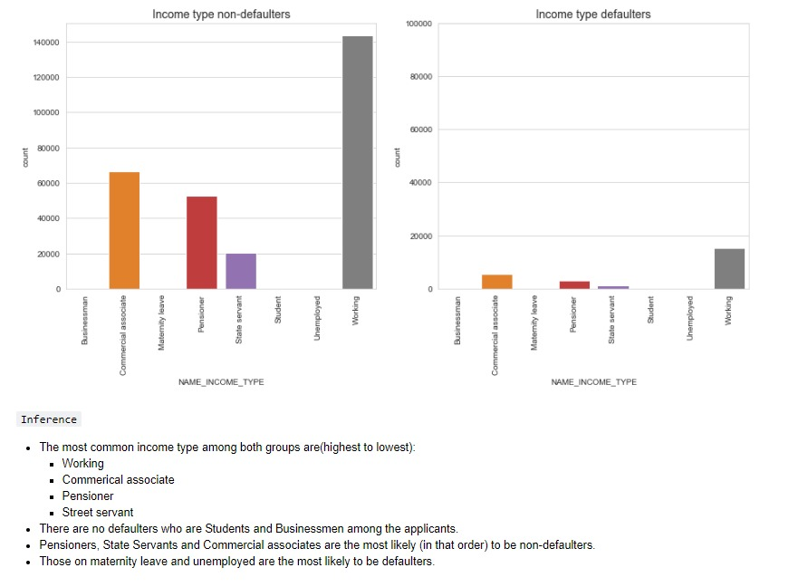

Slide 18
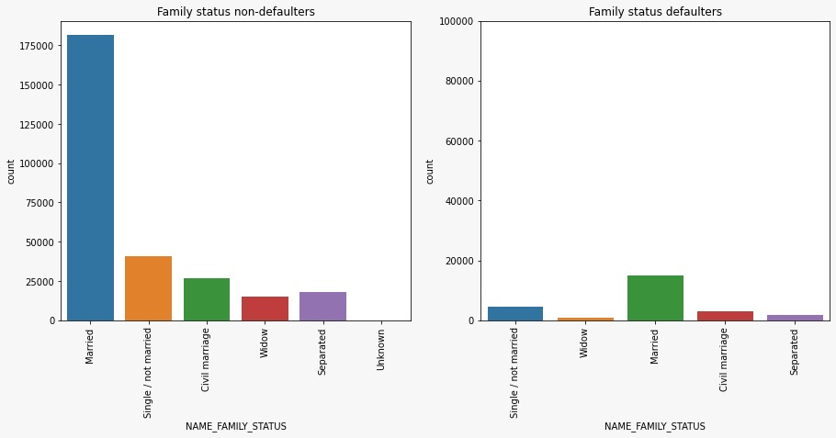


Slide 19
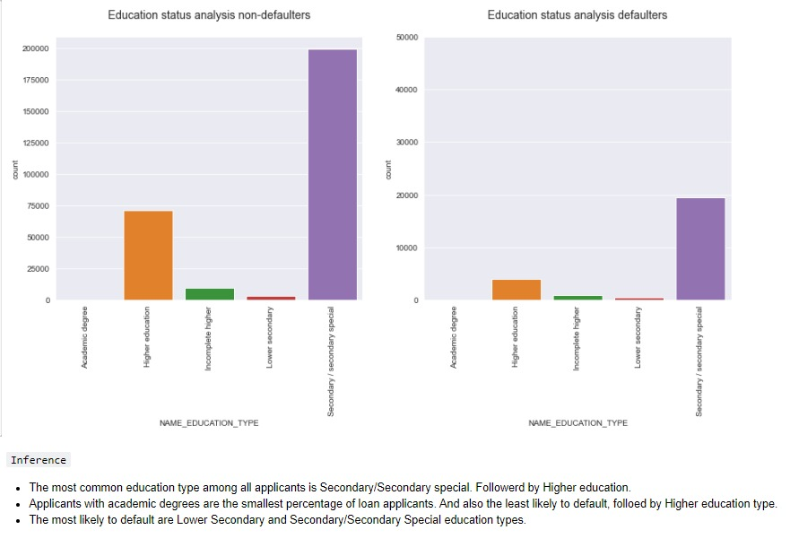

Slide 20
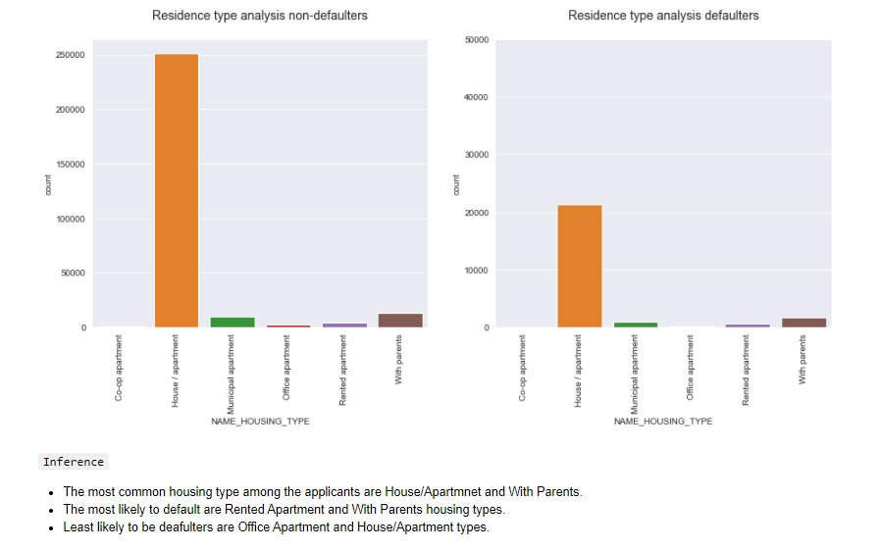

Slide 21
NUMERICAL UNIVARIATE ANALYSIS

Slide 22
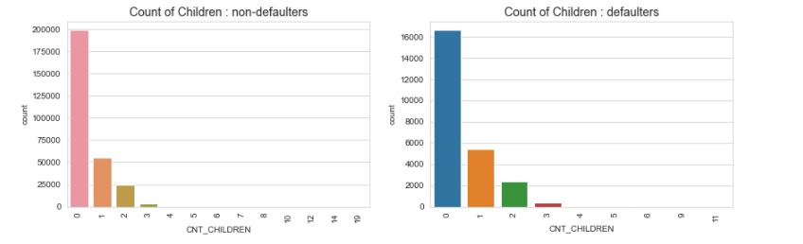
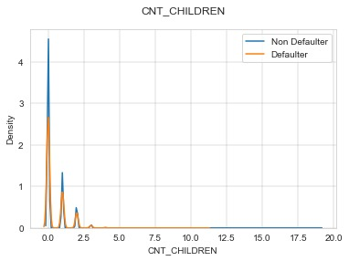
INFERENCE:
Most applicants have no children.
Applicants with more than 3 children are more likely to default.

Slide 23
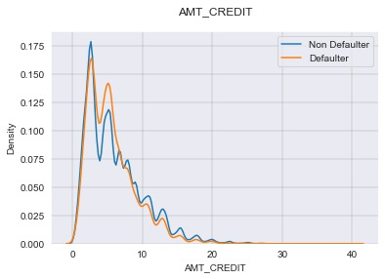
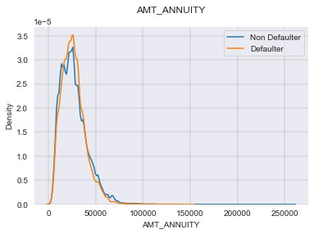
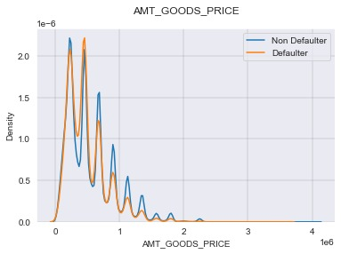
According to the above distributions:
The majority of applicants have taken a credit loan amount less than 1 million.
The Amount Annuity paid by applicants is less than 75,000, with majority below 50,000.
The majority of the distribution of Goods Price among applicants is less than 100,000.

Slide 24
NUMERICAL BIVARIATE ANALYSIS

Slide 25
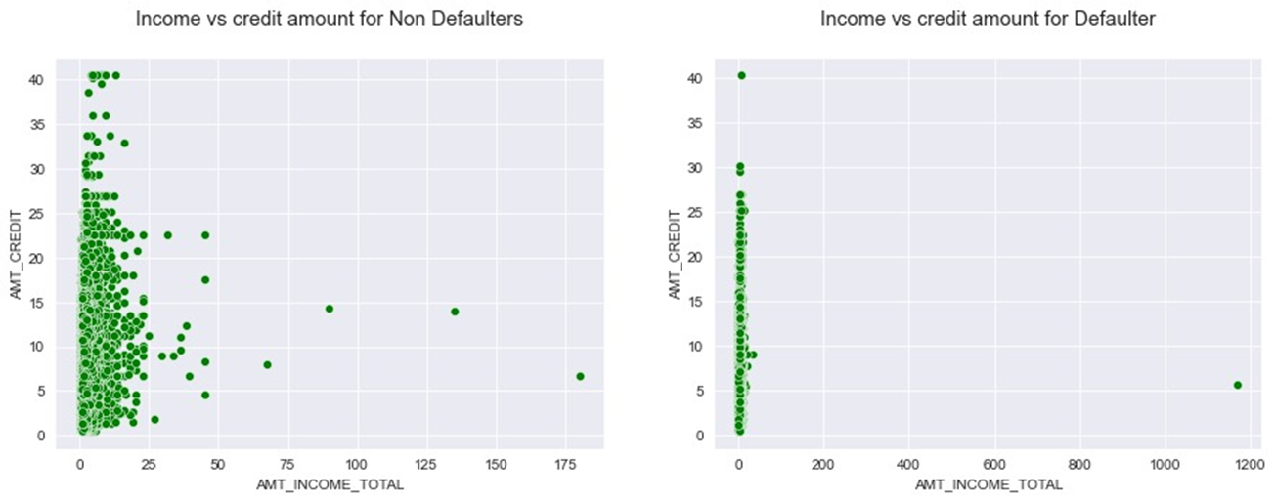
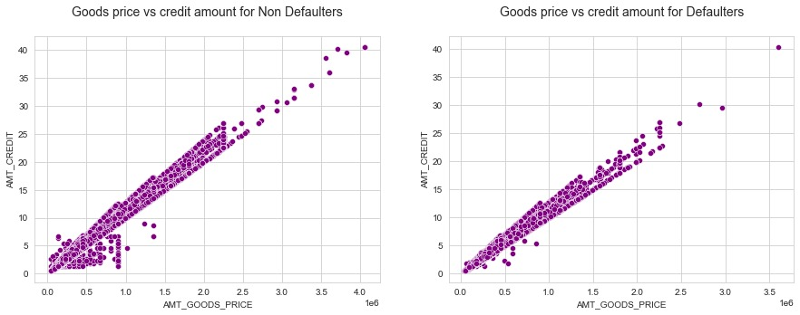
INFERENCE:
Those who have paid the loan amount on/within time are more likely to get higher credits than those who didn’t pay/did late payments. People who have higher goods price and have made payments on time have higher credits than those with higher goods price but didn’t pay loan.

Slide 26
Other categorical and numerical variable analysis

Slide 27
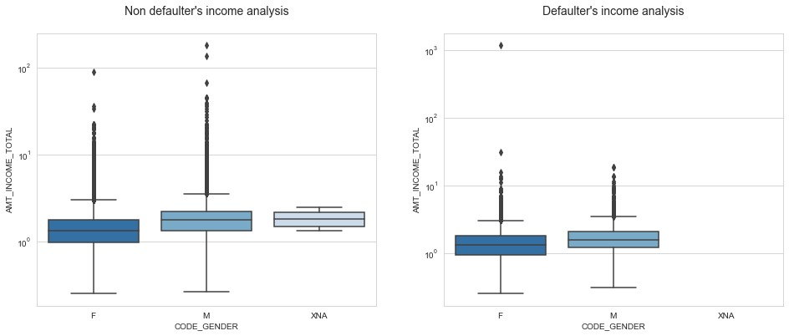
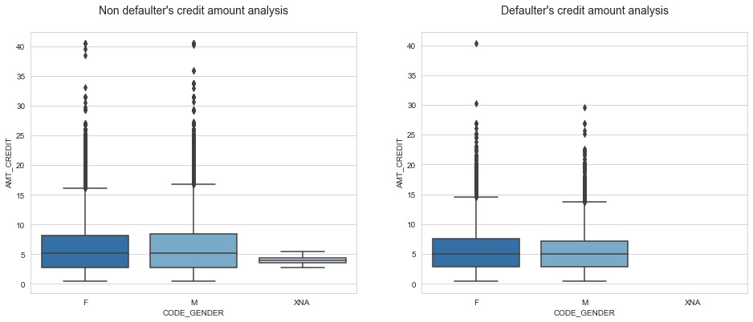
INFERENCE:
It seems that the male clients are having higher income than females. But as observed the female clients are more in number than the male clients.
The credit amount for both male and female clients are approximately equal for both defaulters and non defaulters. In this case, the credit amount for females seem a little higher.
As a suggestion, it can be inferred that the organization should target male clients more as there is a very high possibility for them to go for higher credits leading towards profitability of the organization.

Slide 28
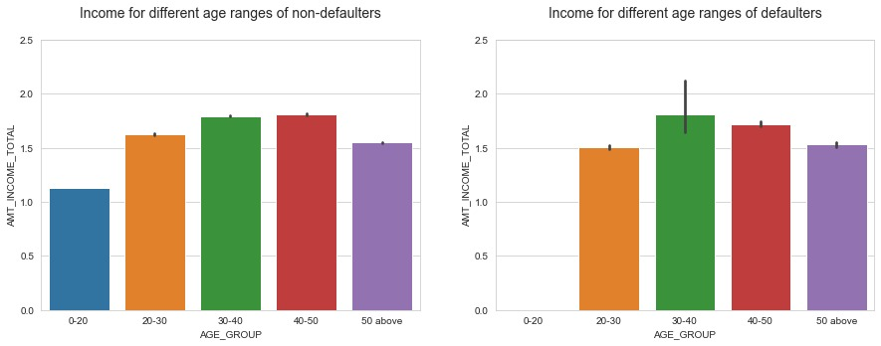
AGE VS INCOME

Slide 29
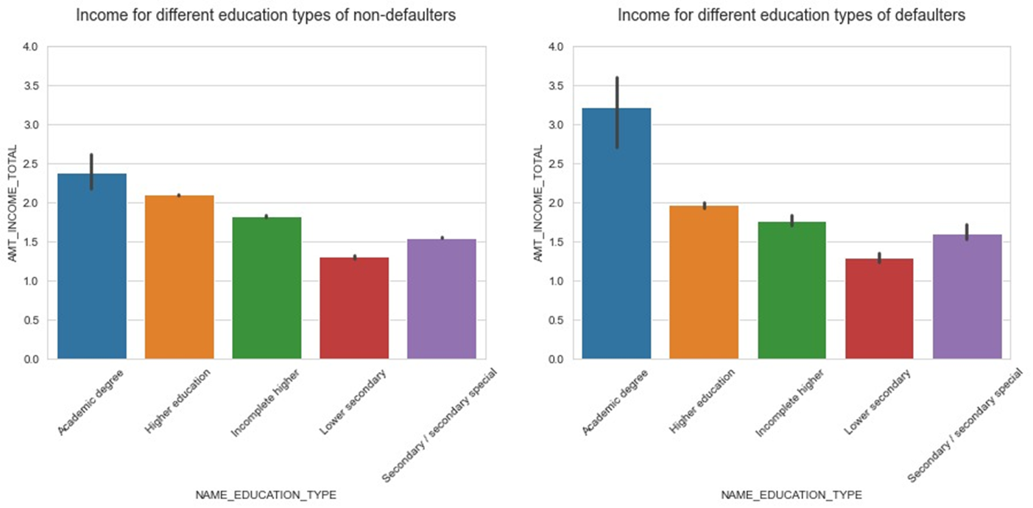
EDUCATION VS INCOME

Slide 30
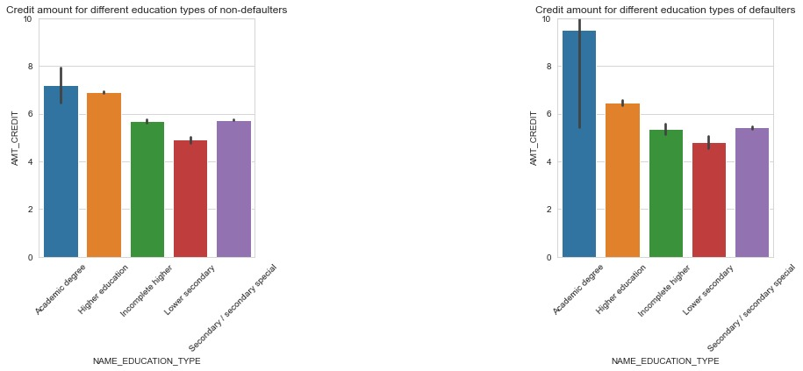
EDUCATION VS CREDIT AMOUNT

Slide 31
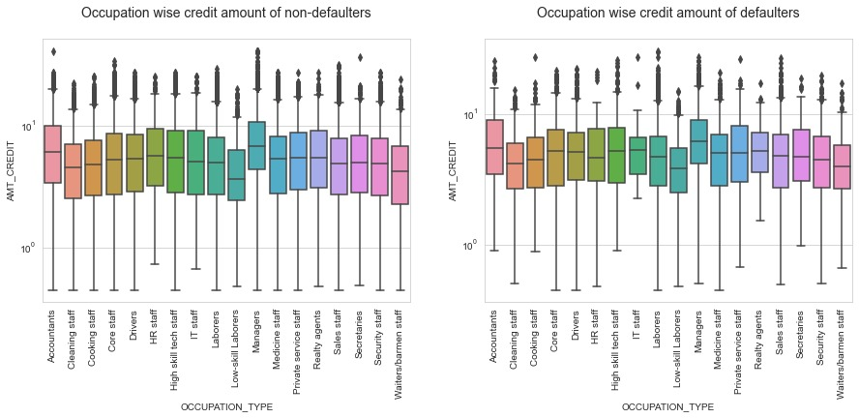
OCCUPATION VS CREDIT AMOUNT

Slide 32
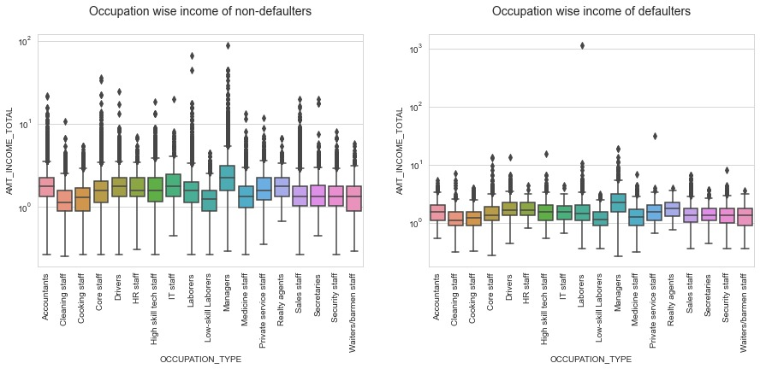
OCCUPATION VS INCOME

Slide 33
INFERENCE
From the visualizations presented earlier, we can conclude that the people between age range of 40-50 with an academic degree are taking greater amount of loans and paying on time. Also mostly of occupation type managers are able to repay the loan on time.

Slide 34
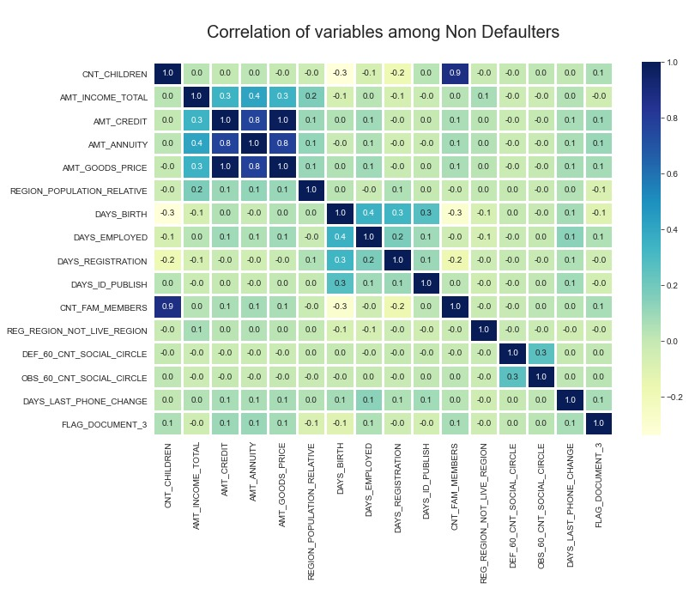
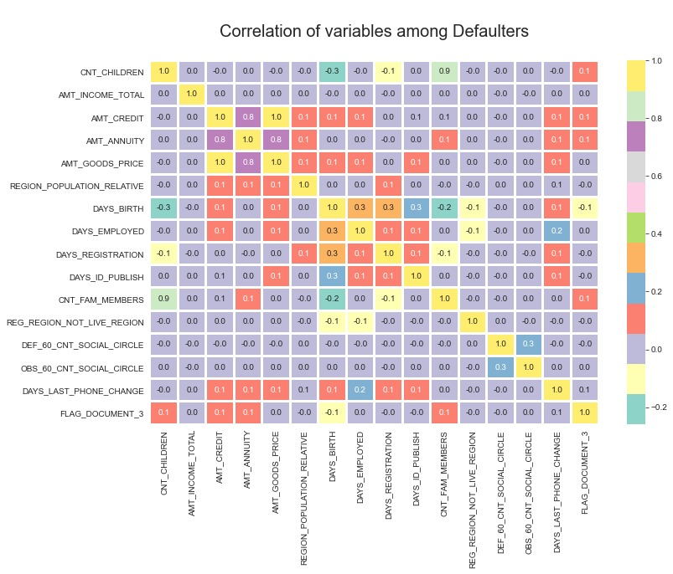
CORRELATION MATRIX
The variables with positive correlation (above 0.4) among both defaulters and non-defaulters are:
AMT_CREDIT
AMT_GOODS_PRICE
AMT_ANNUITY
CNT_CHILDREN
CNT_FAM_MEMBERS
AMT_INCOME_TOTAL

Slide 35
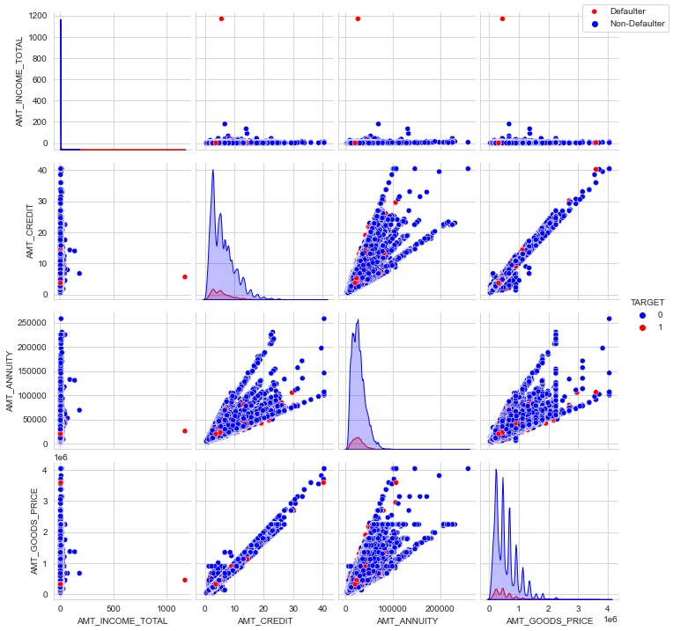
PLOTS for POSITIVE CORRELATION
This pair plot indicates a strong positive linear relationship between AMT_CREDIT and AMT_GOODS_PRICE.
These columns are highly correlated. Most defaulters have AMT_ANNUITY below 150,000. Meaning, there are fewer defaulters with AMT_ANNUITY > 150,000.
Most defaulters are below AMT_GOODS_PRICE of 3 million.
There are fewer defaulters with AMT_CREDIT and AMT_GOODS_PRICE>3 million.

Slide 36
ANALYSIS OF MERGED DATA FRAME

Slide 37
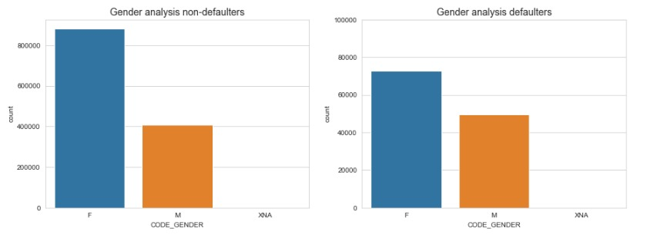
GENDER ANALYSIS

Slide 38
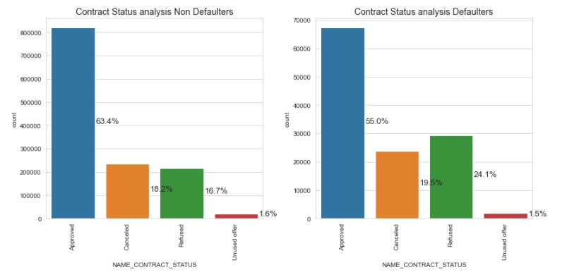
CONTRACT STATUS ANALYSIS
INFERENCE:
90% of applicants who previously had cancelled loans are non-defaulters.
Applicants who had previously been refused loans are the second highest percentage among defaulters.
88% of applicants who had previously been refused loans are non-defaulters.

Slide 39
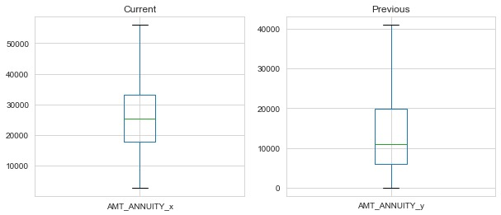
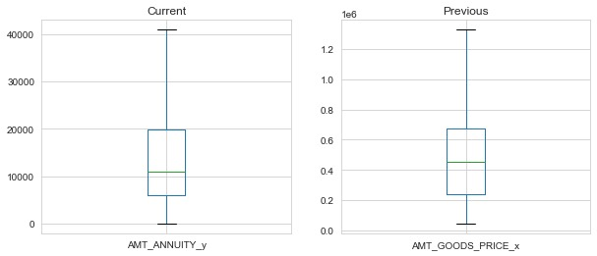
INFERENCE:
AMT_ANNUITY among current applicants is higher than among previous applicants with a uniform distribution.
AMT_GOODS_PRICE among current applicants is much lower compared to previous applicants.

Slide 40
FINAL CONCLUSION
Applicants who live own a car. Those with academic degrees are less likely to default. Student and businessman have no defaulters in our data.
Above the age of 50 unlikely to default.
Target pensioners, students and businessman for offering loans.
Target applicants with no children as they are less likely to default.
Offer lower interest rates to target field applicants.
Income below 300K are more likely to default. Offer higher interest rate.
Applicants in rented apartments or living with parents are more likely to default. Offer partial loans or higher interest rates.
Low skill laborers, drivers, Waiters/Bar men staff and security staff are have higher probability of defaulting. Use stricter requirements to avail a loan for applicants from these occupations.
Unemployed and maternity leave income types are more likely defaulters. Avoid such income types when for approving loans.
Applicants with 4 or more children or more than 5 family members are likely to be defaulters. Offer higher interest rates.
Applicants with 200-600K credit amount are more likely to default. As 200-300K credit range is the most common among applicants, offering higher interest rates or partial loans is advised.
Over 1 million credit loan are less likely to default, so target applicants with higher loan credits.
Applicants who have previously been refused loans have not defaulted. Inquire reasons for refused loan and introduce re-examination of loans for refused applicants to target them for future loan offers.

